Slide 1
Vmware Vfabric – Spring tc Server

Slide 2



Elastic Application Server: Lightweight Application Platform
JEE Server
tc Server
Tomcat
Heavyweight App Container
Lightweight App Container
Enterprise Capabilities
Enterprise Capabilities
(?)
tc Server is Enterprise Tomcat – The best of both worlds
Optimized for Cloud/Virtualization
Same great high performance, low complexity, lean platform (10 MB Server)
Best platform to run Spring (or any non-EJB Java) applications on
Has Features/Capabilities Enterprises need and expect
Management, Monitoring, Diagnostics, Support
Notes:
If you remember the picture we spoke about at the beginning, traditional IT has loved heavyweight enterprise application servers. These servers are required to host applications. Traditional JEE servers are very large engines that provide a large number of enterprise capabilities (such as monitoring, management, support, etc.). Because of these command and control capabilities, IT Ops has favored these large engines of enterprises past. On the opposite end of the spectrum is this very lightweight container called Tomcat. Tomcat is free and a fraction of the size of JEE servers. As an example, WebLogic and WebSphere are both around a gig in size. Tomcat is around 9 meg. What VMware is doing with vFabric tcServer is bring all of these enterprise capabilities to the Tomcat application container. So, if you are deploying 1 instance of WebLogic to an HP Superdome, do you care that WebLogic requires a lot of CPU, memory, etc.? Not really. If you are looking to deploy 50 VMs to a more cost effective vBlock, do you want a huge WL instance in every VM? No way. It becomes imperative to drive more efficiency with a light-weight approach, especially if I can still get those enterprise capabilities. This is not even considering price, where tcServer is typically 1/10th the cost with a very strong long term TCO.

Slide 3



SpringSource tc Server: Key Highlights
Developer
Efficiency
Familiar Spring + Tomcat experience
Deep performance insight into Spring apps
Agile Spring development experience via STS
Performance & SLA management of Spring apps
Application provisioning and server administration
Rich alert definition, workflows, and control actions
Group availability & event dashboards
Secure unidirectional agent communications
Operational
Control
Lean server (10 MB) ideal for virtual environments
Template-driven server instance creation
Integrated experience with VMware environments
Open, secure API for all operations
Deployment
Flexibility

Slide 4



SpringSource tc Server: Key Highlights
Developer
Efficiency
Familiar Spring + Tomcat experience
Deep performance insight into Spring apps
Agile Spring development experience via STS
Performance & SLA management of Spring apps
Application provisioning and server administration
Rich alert definition, workflows, and control actions
Group availability & event dashboards
Secure unidirectional agent communications
Operational
Control
Lean server (10 MB) ideal for virtual environments
Template-driven server instance creation
Integrated experience with VMware environments
Open, secure API for all operations
Deployment
Flexibility

Slide 5
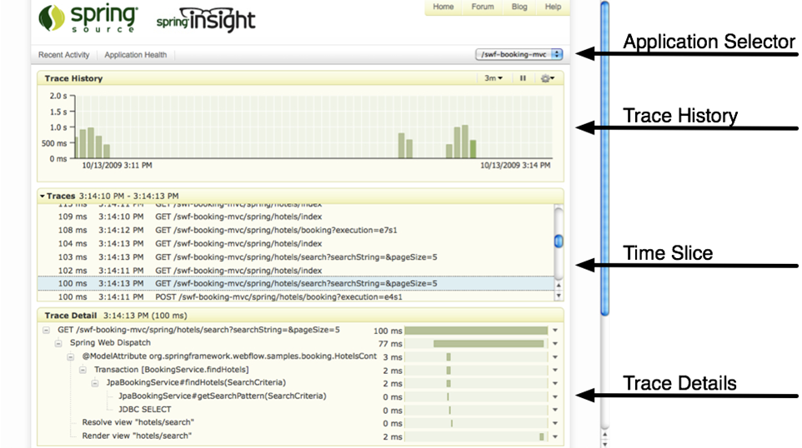
Developer Efficiency: Deep Performance Insight into Spring Apps

Slide 6
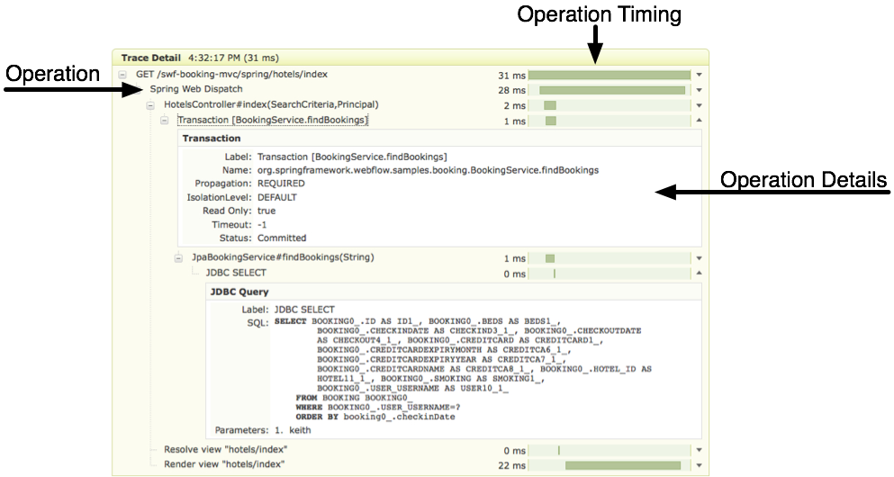
Developer Efficiency: Deep Performance Insight into Spring Apps
(cont’d)

Slide 7

Developer Efficiency: Agile Spring Development Experience
SpringSource Tool Suite
Rich visual tools for rapidly building modern applications
Spring 3.0, Spring Roo, Groovy & Grails tools
Encourages agile development and testing
Tight integration with tc Server minimizes application redeploys/restarts
Links performance issues to code traces highlighted in Spring Insight
Supports flexible deployment targets
tc Server, Java EE servers, VMware, Cloud, etc.
Spring Roo
Grails
Spring
(Core, Rich Web, Integration)
Java
Groovy
tc Server
(Spring Insight)
Notes:
SpringSource Tool Suite (STS) provides the best way for a developer to get started with Spring or Grails.
Since it embeds the developer edition of tc Server, developers get the benefits of using the Spring Insight performance dashboard which automatically instrucments their existing Spring applications and provides deep insight into Spring application performance.
STS provides a rich set of visual tools, wizards, code generation tools and tutorials that help a developer create applications very quickly.
STS enables developers to deploy their applications onto any Java application server (tc Server, WebLogic, etc), deploy into VMware Workstation and VMware Lab Manager environments, and deploy into cloud platforms such as Cloud Foundry. The key point here is that we provide c consistent developer experience no matter what the deployment target may be (developer desktop, data center, or cloud)

Slide 8
SpringSource tc Server: Key Highlights
Developer
Efficiency
Familiar Spring + Tomcat experience
Deep performance insight into Spring apps
Agile Spring development experience via STS
Performance & SLA management of Spring apps
Application provisioning and server administration
Rich alert definition, workflows, and control actions
Group availability & event dashboards
Secure unidirectional agent communications
Operational
Control
Lean server (10 MB) ideal for virtual environments
Template-driven server instance creation
Integrated experience with VMware environments
Open, secure API for all operations
Deployment
Flexibility

Slide 9

Operational Control: Production Deployment Architecture
Server 1
Management Server
Administration, Provisioning, Groups, Metrics, Alerts, Events, Access Control, Agent Upgrades, etc.
Web
Dashboard
tc Server
Instance 1
tc Server
Instance 1
tc Server
Instance 1
Spring
Agent
Open API
Server 2
Inventory, Metric, Audit, …
Server 1
tc Server
Instance 1
Seamlessly Upgradeable
tc Server
Instance 1
tc Server
Instance 1
tc Server
Instance 1
tc Server
Instance 1
tc Server
Instance 1
Spring
Agent
Agent
Hyperic Monitoring
Web Servers, App Servers, Databases, Caching, Messaging, Directories, Virtualization, etc.
Spring
Spring
Spring
Notes:
http://static.springsource.com/projects/tc-server/6.0/getstart/cgscreateinst.html#cgscreateinst__templates
Create multiple instances of tc Server with a single set of binaries. This adds the following value for customers:
A single installation of tc Server (that uses the SpringSource layout) supports multiple running tc Server instances.
One set of binaries means easy upgrades of all the associated instances.
Multiple separate instances allows testing of configuration and code changes without touching the production instance.

Slide 10
Operational Control: Enhanced Tomcat-compatible Server
Apache Tomcat
Enterprise Capabilities
Servlet 2.5 (JSR 154)
Java Server Pages 2.1 (JSR 245)
Clustering Features
Session & context attribute replication
Load balancing
Improved over Tomcat 5.x
Advanced I/O Features
Improvements in Memory Usage
Stable, Fast, Lightweight
Tomcat Compatibility
Runs existing Tomcat applications
Leverages existing skill-sets
Run multiple instances per install
Centralizes tc Server install/updates
Enterprise-ready stable release
Security vulnerabilities & bug fixes
Fixes will be in upstream open source release
Built, certified and pre-tuned
Advanced Scalability Options
Non-blocking (NIO) connectors
High concurrency connection pool
Advanced Diagnostics
Detects deadlocks and slow running requests
Provides access to SQL behind slow requests
Identifies time spent in garbage collection
Notes:
tc Server also enhances its Tomcat compatible core with advanced diagnostics. For example, tc Server supports request level diagnostics that detect slow running requests and identifies the time spent during the request in garbage collection and database operations - frequent causes of slow requests. The diagnostics for database operations provide access to the SQL that triggered the slow request making root cause analysis significantly simpler.

Slide 11
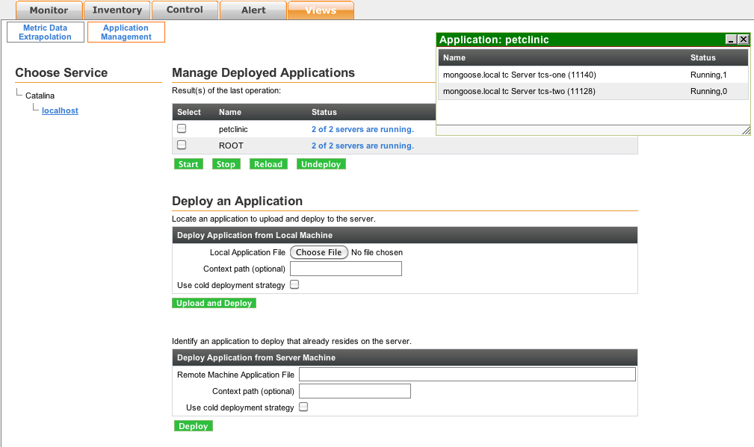

Operational Control: Application Provisioning
Provision applications to single server or group of servers
Manage deployed applications
View application status
Start, stop, reload, and undeploy applications

Slide 12
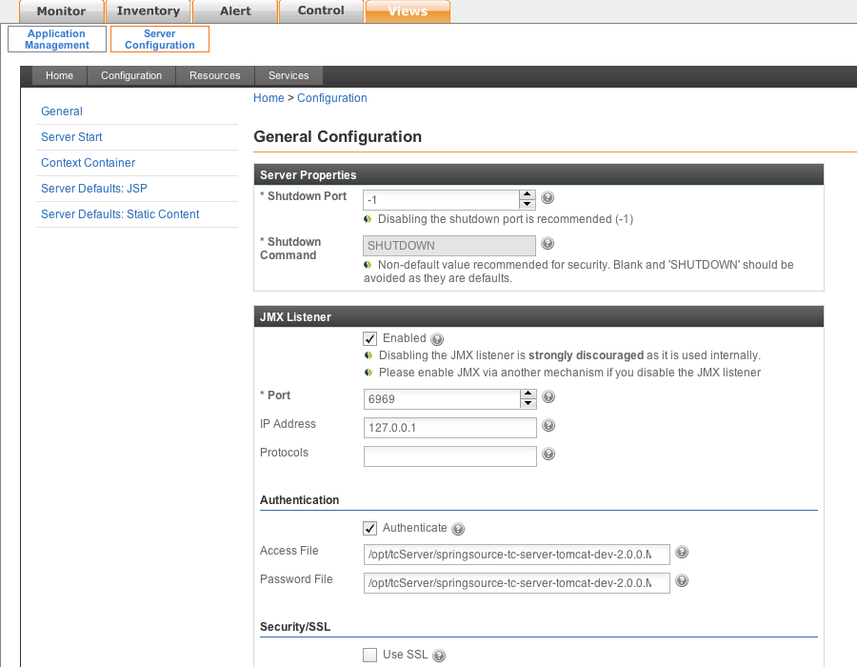
Operational Control: Server Administration & Configuration
Centralized administration of server configuration and defaults
Out of box pre-tuned configurations
JVM Options, production configurations, automated boot scripts, Windows service wrapper
Server Instance Templates

Slide 13
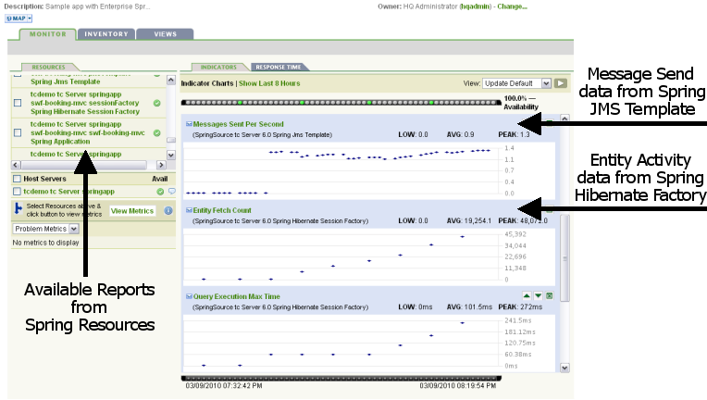
Operational Control: Performance & SLA Mgmt of Spring apps
Automatically Monitor Application, Data Access, Custom Components
@Controller, @Service, @Component, @Transactional, @Repository, @ManagedResource
Executions Per Second, Average Execution Time, Maximum Time, Minimum Time, etc.
Monitor Performance and Execute Control Operations inside Spring
Transaction Manager, Hibernate Session, Message Listener, JMS, JavaMail, Thread Pool, etc.
Start/Stop Listener, Set Max Messages, Set Receive Timeout, Set Pool Size, Set Keep Alive, etc.
Notes:
Automatically monitors execution times for code that uses @Controller, @Service, @Component, @Transactional, and @Repository stereotyped annotations:
Metrics: AverageElapsedExecutionTime(ms), ExecutionsPerSecond, InvocationCount, MaximumExecutionTime(ms), MinimumExecutionTime(ms), ThrownExceptionCount
NOTE: @Controller, @Service, and @Component are typically key endpoints within an application worth measuring, and @Repository and @Transactional handle data access and transaction management, both of which are worth measuring. People using these Spring annotations get these metrics collected automatically (no extra work on their part).
We also monitor execution times and enable operations to be executed across a range of standard Spring components such as:
Platform Transaction Manager:
Metrics: CommitsPerSecond, FailedCommits, FailedResumes, FailedRollbacks, FailedSuspends, ResumesPerSecond, RollbacksPerSecond, SuspendsPerSecond
Hibernate Session Factory has over 40 metrics exposed including:
Metrics: QueryExecutionMaxTime(ms), QueryExecutionCount, QueryCacheHitCount, QueryCacheMissCount, EntityLoadCount, EntityInsertCount, , EntityUpdateCount, EntityDeleteCount, …
Default Message Listener Container:
Metrics: ActiveConsumers, AverageElapsedTimePerMessage(ms), FailedMessages, MessagesPerSecond, MessagesReceived, ScheduledConsumers
Operations: start, stop, set Concurrent Consumers, set Max Concurrent Consumers, scale Max Concurrent Consumers, set Max Messages Per Task, set Idle Task Execution Limit
JMS Template:
Metrics: AverageElapsedTimePerMessageSent(ms), FailedMessageSends, MessagesSent, MessagesSentPerSecond
Operations: set Receive Timeout
Java Mail Sender:
Metrics: AverageElapsedTimePerMessage(ms), FailedMessages, MessagesSent, MessagesPerSecond
Operations: setHost, setPort
Thread Pool Task Executor:
Metrics: ActiveTasks, LargestPoolSize, PoolSize, QueueSize
Operations: set Core Pool Size, set Max Pool Size, set Keep Alive Seconds

Slide 14
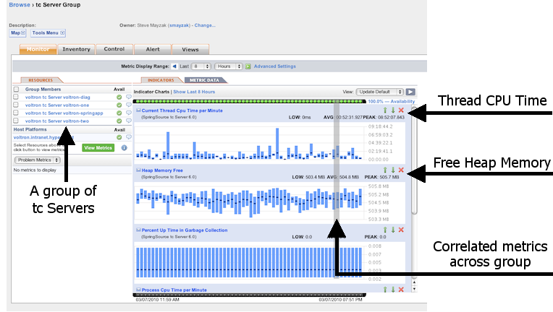
Operational Control: Performance & SLA Mgmt of Spring apps
(cont’d)
Monitor Application Server Status, Health, and Response Times
Availability, Throughput, Utilization, Connection & Thread Pool Health, Deadlock Detection, Garbage Collection
Notes:
Automatically monitors execution times for code that uses @Controller, @Service, @Component, @Transactional, and @Repository stereotyped annotations:
Metrics: AverageElapsedExecutionTime(ms), ExecutionsPerSecond, InvocationCount, MaximumExecutionTime(ms), MinimumExecutionTime(ms), ThrownExceptionCount
NOTE: @Controller, @Service, and @Component are typically key endpoints within an application worth measuring, and @Repository and @Transactional handle data access and transaction management, both of which are worth measuring. People using these Spring annotations get these metrics collected automatically (no extra work on their part).
We also monitor execution times and enable operations to be executed across a range of standard Spring components such as:
Platform Transaction Manager:
Metrics: CommitsPerSecond, FailedCommits, FailedResumes, FailedRollbacks, FailedSuspends, ResumesPerSecond, RollbacksPerSecond, SuspendsPerSecond
Hibernate Session Factory has over 40 metrics exposed including:
Metrics: QueryExecutionMaxTime(ms), QueryExecutionCount, QueryCacheHitCount, QueryCacheMissCount, EntityLoadCount, EntityInsertCount, , EntityUpdateCount, EntityDeleteCount, …
Default Message Listener Container:
Metrics: ActiveConsumers, AverageElapsedTimePerMessage(ms), FailedMessages, MessagesPerSecond, MessagesReceived, ScheduledConsumers
Operations: start, stop, set Concurrent Consumers, set Max Concurrent Consumers, scale Max Concurrent Consumers, set Max Messages Per Task, set Idle Task Execution Limit
JMS Template:
Metrics: AverageElapsedTimePerMessageSent(ms), FailedMessageSends, MessagesSent, MessagesSentPerSecond
Operations: set Receive Timeout
Java Mail Sender:
Metrics: AverageElapsedTimePerMessage(ms), FailedMessages, MessagesSent, MessagesPerSecond
Operations: setHost, setPort
Thread Pool Task Executor:
Metrics: ActiveTasks, LargestPoolSize, PoolSize, QueueSize
Operations: set Core Pool Size, set Max Pool Size, set Keep Alive Seconds

Slide 15
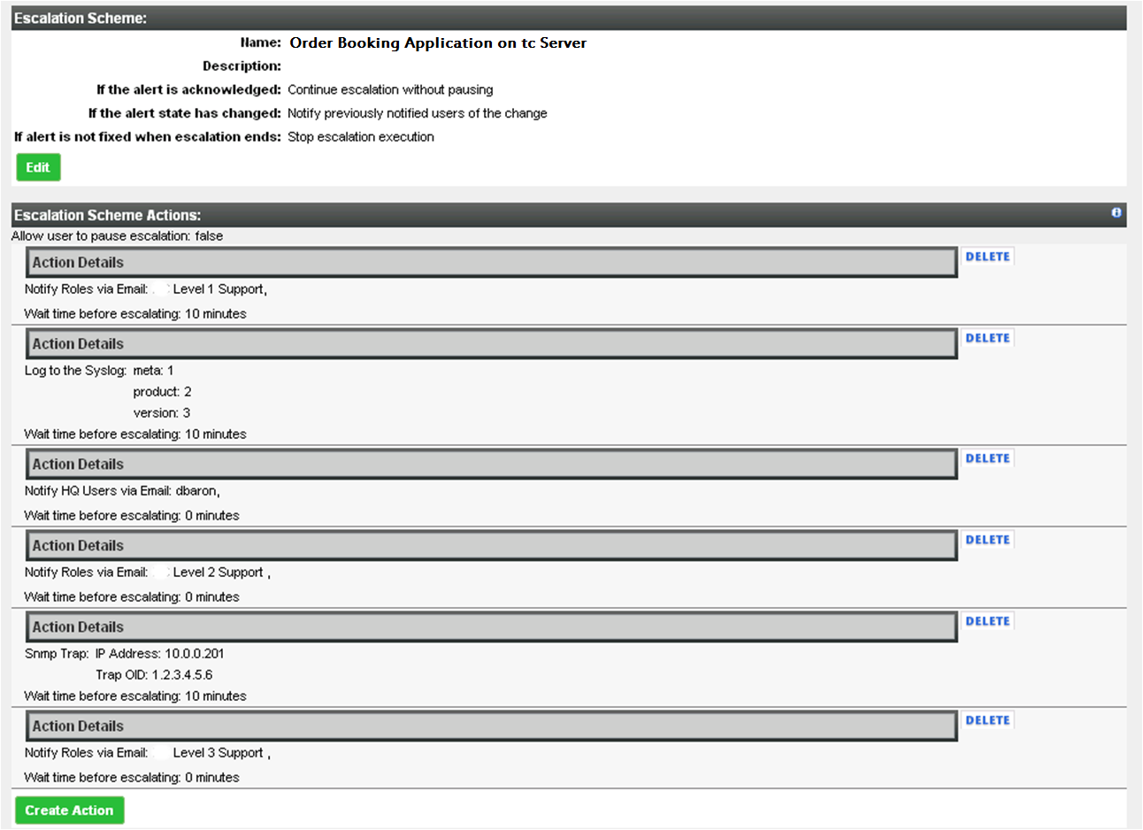
Operational Control: Alert Workflows and Control Actions

Slide 16
SpringSource tc Server: Key Highlights
Developer
Efficiency
Familiar Spring + Tomcat experience
Deep performance insight into Spring apps
Agile Spring development experience via STS
Performance & SLA management of Spring apps
Application provisioning and server administration
Rich alert definition, workflows, and control actions
Group availability & event dashboards
Secure unidirectional agent communications
Operational
Control
Lean server (10 MB) ideal for virtual environments
Template-driven server instance creation
Integrated experience with VMware environments
Open, secure API for all operations
Deployment
Flexibility

Slide 17
Deployment Flexibility: tc Server Instance Templates
Streamlines process of spinning up new server instances
Script-driven templates deliver uniquely named server instances in seconds
Run multiple instances based on a single set of server binaries
Pre-packaged templates for popular configurations provided out of the box
Separates server runtime, configuration, and applications in a way that makes testing changes and making updates a breeze
Instance templates contain:
Server, web, and context configuration files
Parameterized properties files (ex. ports, etc.)
Custom scripts, custom shared resource libraries, etc.
Web applications (ex. Spring Insight)
Example use cases:
Dev, QA, Performance Test, Staging, and Production templates
Templates for multiple instances on a machine serving a specific application
Notes:
http://static.springsource.com/projects/tc-server/6.0/getstart/cgscreateinst.html#cgscreateinst__templates
Create multiple instances of tc Server with a single set of binaries. This adds the following value for customers:
A single installation of tc Server (that uses the SpringSource layout) supports multiple running tc Server instances.
One set of binaries means easy upgrades of all the associated instances.
Multiple separate instances allows testing of configuration and code changes without touching the production instance.

Slide 18

Deployment Flexibility: tc Server Instances (large physical box)
tc Server
Instance 1
tc Server
Instance m
tc Server
Instance X
. . .
Spring
Spring
Spring
Spring
Spring
tc Server ver X
(shared binaries)
. . .
tc Server ver Y
(shared binaries)
Operating System & JVM
Single lightweight (10MB) install for multiple running instances
Shared binaries eases upgrades of all instances
Separates configuration and code from server runtime
Multiple server versions can be installed per machine
Notes:
http://static.springsource.com/projects/tc-server/6.0/getstart/cgscreateinst.html#cgscreateinst__templates
Create multiple instances of tc Server with a single set of binaries. This adds the following value for customers:
A single installation of tc Server (that uses the SpringSource layout) supports multiple running tc Server instances.
One set of binaries means easy upgrades of all the associated instances.
Multiple separate instances allows testing of configuration and code changes without touching the production instance.

Slide 19

Deployment Flexibility: tc Server Instances (virtualized platform)
Medium Virtual Machine
tc Server
Instance 1
tc Server
Instance m
. . .
Small VM
Small VM
Spring
Spring
Spring
Spring
tc Server
(shared binaries)
tc Server
tc Server
Operating System & JVM
OS & JVM
OS & JVM
Virtual Infrastructure Platform
Complete flexibility to deploy large, medium, and small “machines”
Lightweight footprint ensures maximum resource utilization
Notes:
http://static.springsource.com/projects/tc-server/6.0/getstart/cgscreateinst.html#cgscreateinst__templates
Create multiple instances of tc Server with a single set of binaries. This adds the following value for customers:
A single installation of tc Server (that uses the SpringSource layout) supports multiple running tc Server instances.
One set of binaries means easy upgrades of all the associated instances.
Multiple separate instances allows testing of configuration and code changes without touching the production instance.

Slide 20
Elastic Memory for Java – EM4J
EM4J manages a memory balloon that sits directly in the Java heap
EM4J works with the hypervisor to communicate system-wide memory pressure directly into the Java heap.
EM4J forces Java to clean up proactively and return memory at the most appropriate times—when it is least active.
You no longer have to be so conservative with your heap sizing because unused heap memory is no longer wasted on uncollected garbage objects.
EM4J ensures that memory is used more efficiently, without risking sudden and unpredictable performance problems.
Notes:
http://static.springsource.com/projects/tc-server/6.0/getstart/cgscreateinst.html#cgscreateinst__templates
Create multiple instances of tc Server with a single set of binaries. This adds the following value for customers:
A single installation of tc Server (that uses the SpringSource layout) supports multiple running tc Server instances.
One set of binaries means easy upgrades of all the associated instances.
Multiple separate instances allows testing of configuration and code changes without touching the production instance.

Slide 21
How ESXi and EM4J Improve Memory Utilization
A chief benefit of virtualization is the ability to maximize physical host resources by adding virtual machines to consume unused computing capacity.
Recouping unused CPU cycles lowers the costs of hardware, service, management, maintenance, and energy.
Available physical memory can limit the number of virtual machines you can deploy on a host, even when CPU is still underutilized.
To get the most out of your hardware, you can either add more physical memory or use the existing memory more efficiently.
Notes:
http://static.springsource.com/projects/tc-server/6.0/getstart/cgscreateinst.html#cgscreateinst__templates
Create multiple instances of tc Server with a single set of binaries. This adds the following value for customers:
A single installation of tc Server (that uses the SpringSource layout) supports multiple running tc Server instances.
One set of binaries means easy upgrades of all the associated instances.
Multiple separate instances allows testing of configuration and code changes without touching the production instance.

Slide 22
How ESXi and EM4J Improve Memory Utilization
ESXi ensures the efficient use of physical memory by employing
shared memory pages,
ballooning,
memory compression and, as a last resort,
disk swapping.
Notes:
http://static.springsource.com/projects/tc-server/6.0/getstart/cgscreateinst.html#cgscreateinst__templates
Create multiple instances of tc Server with a single set of binaries. This adds the following value for customers:
A single installation of tc Server (that uses the SpringSource layout) supports multiple running tc Server instances.
One set of binaries means easy upgrades of all the associated instances.
Multiple separate instances allows testing of configuration and code changes without touching the production instance.

Slide 23
Memory Utilization Techniques
Transparent Page Sharing:
scans memory pages in virtual machines for duplicate contents and can reduce memory overhead by eliminating the duplication.
Duplicate pages are mapped to the same physical page,
and if a virtual page is modified, a unique new copy is created transparently.
Example: initialized memory pages can be shared if they are written with zeros and static code in virtual machines running the same OS and applications.
Notes:
http://static.springsource.com/projects/tc-server/6.0/getstart/cgscreateinst.html#cgscreateinst__templates
Create multiple instances of tc Server with a single set of binaries. This adds the following value for customers:
A single installation of tc Server (that uses the SpringSource layout) supports multiple running tc Server instances.
One set of binaries means easy upgrades of all the associated instances.
Multiple separate instances allows testing of configuration and code changes without touching the production instance.

Slide 24
Memory Utilization Techniques
Memory Compression
ESXi employs memory compression to avoid swapping when memory becomes tight
To free memory, ESXi attempts to compress memory pages and save them in a compression cache.
Compressing and decompressing uses CPU cycles, but is still far more efficient than disk I/O.
Memory compression is the last opportunity to reclaim memory before disk swapping.
Notes:
http://static.springsource.com/projects/tc-server/6.0/getstart/cgscreateinst.html#cgscreateinst__templates
Create multiple instances of tc Server with a single set of binaries. This adds the following value for customers:
A single installation of tc Server (that uses the SpringSource layout) supports multiple running tc Server instances.
One set of binaries means easy upgrades of all the associated instances.
Multiple separate instances allows testing of configuration and code changes without touching the production instance.

Slide 25
Memory Utilization Techniques
VMware Tools Balloon
runs as a process within the virtual machine
allocates and pins unused memory communicates the pages back to the hypervisor.
The memory owned by the balloon driver can then be temporarily de-coupled from the virtual machine and used elsewhere.
Balloons in each host virtual machine expand or shrink depending on the shifting requirements of the virtual machines
Notes:
http://static.springsource.com/projects/tc-server/6.0/getstart/cgscreateinst.html#cgscreateinst__templates
Create multiple instances of tc Server with a single set of binaries. This adds the following value for customers:
A single installation of tc Server (that uses the SpringSource layout) supports multiple running tc Server instances.
One set of binaries means easy upgrades of all the associated instances.
Multiple separate instances allows testing of configuration and code changes without touching the production instance.

Slide 26
Memory Utilization Techniques
EM4J Balloon
The JVM manages its object heap as a single block of memory which is entirely opaque to the OS.
When Java objects become garbage, there is no way that the OS can reclaim this memory, and if the OS cannot reclaim the memory, then neither can the VMware tools balloon.
Hence a balloon operating within the Java heap can be much more efficient.
Notes:
http://static.springsource.com/projects/tc-server/6.0/getstart/cgscreateinst.html#cgscreateinst__templates
Create multiple instances of tc Server with a single set of binaries. This adds the following value for customers:
A single installation of tc Server (that uses the SpringSource layout) supports multiple running tc Server instances.
One set of binaries means easy upgrades of all the associated instances.
Multiple separate instances allows testing of configuration and code changes without touching the production instance.

